Slide 1
LabVIEW
Contact:- 8319146306
Mail:- arinrharsh@gmail.com
Getting Start
Part 3
Nitesh Pradhan
B.Tech Gold Medalist
NIT Raipur
Former Academic Partner of National Instruments

Slide 2
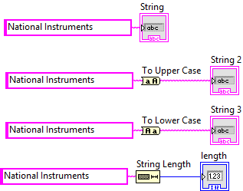
Level one
Solve and give the answer of all Problem
Note:-

Slide 3
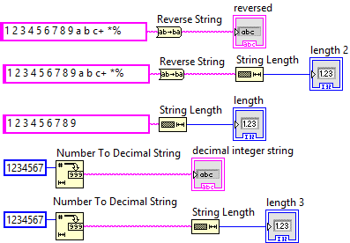
Level one
Solve and give the answer of all Problem
Note:-

Slide 4
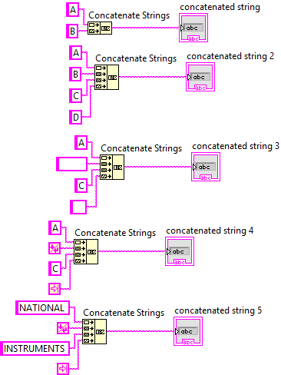
Level one
Solve and give the answer of all Problem
Note:-

Slide 5
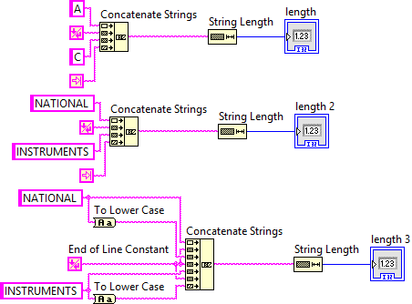
Level one
Solve and give the answer of all Problem
Note:-

Slide 6
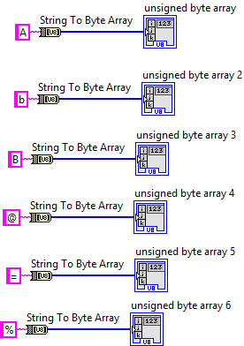
Level one
Solve and give the answer of all Problem
Note:-

Slide 7
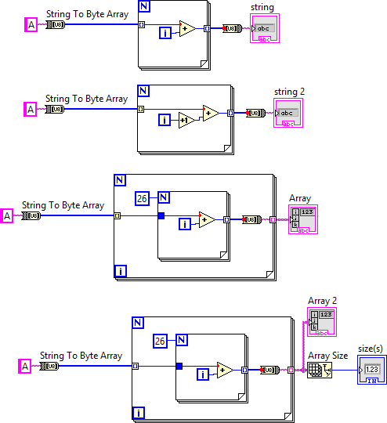
Level one
Solve and give the answer of all Problem
Note:-

Slide 8
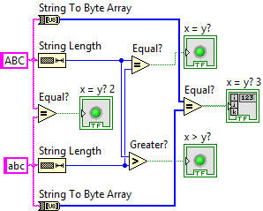
Level one
Solve and give the answer of all Problem
Note:-

Slide 9
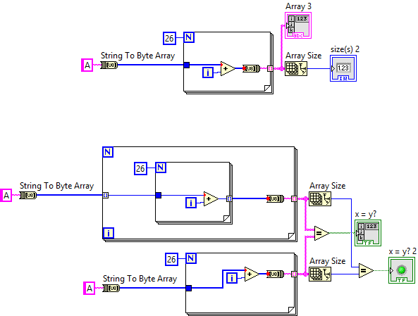
Level one
Solve and give the answer of all Problem
Note:-

Slide 10
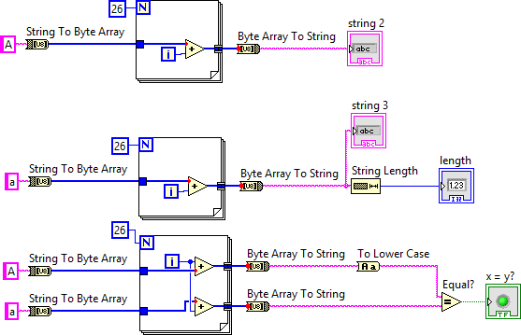
Level one
Solve and give the answer of all Problem
Note:-

Slide 11
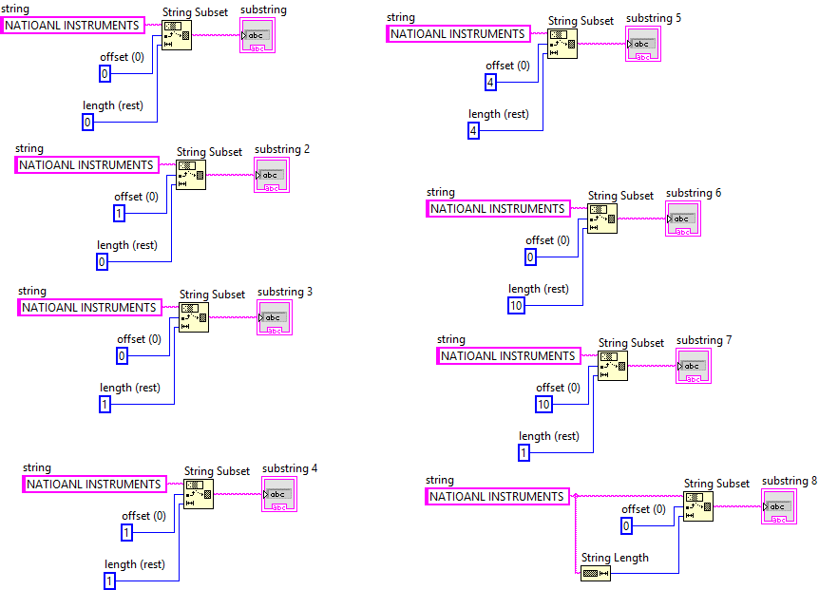
Level one
Solve and give the answer of all Problem
Note:- Here the sapling of National is wrong. Please correct in your Program.

Slide 12
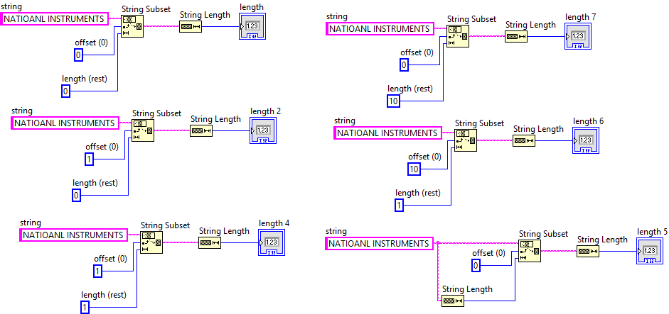
Level one
Solve and give the answer of all Problem
Note:- Here the spelling of National is wrong. Please correct in your Program.

Slide 13
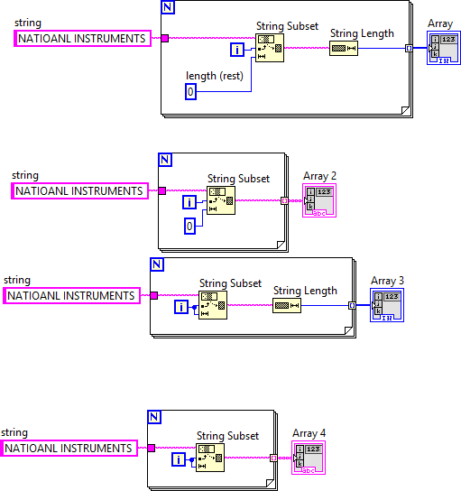
Level one
Solve and give the answer of all Problem
Note:- Here give N = 10

Slide 14
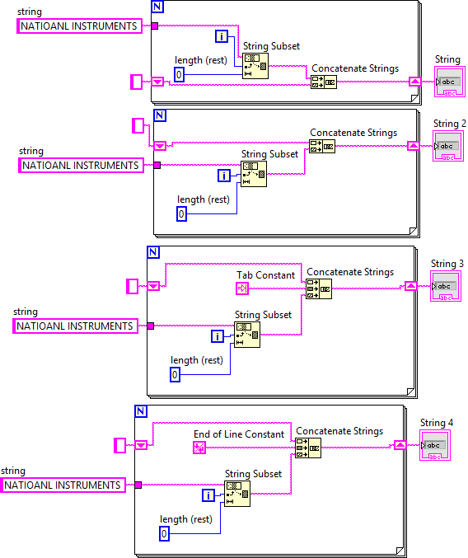
Level one
Solve and give the answer of all Problem
Note:- Here give N = 10

Slide 15
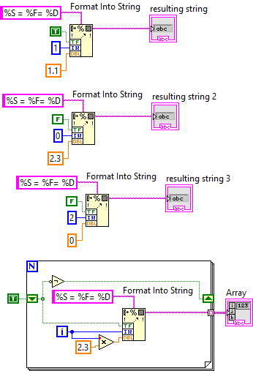
Level one
Solve and give the answer of all Problem
Note:- Here give N = 10

Slide 16
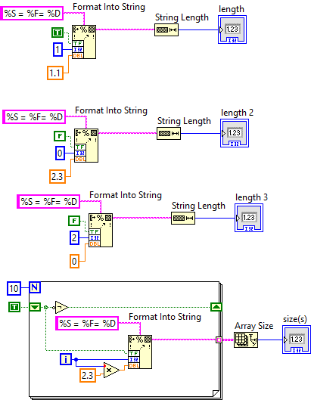
Level one
Solve and give the answer of all Problem
Note:- Here give N = 10

Slide 17
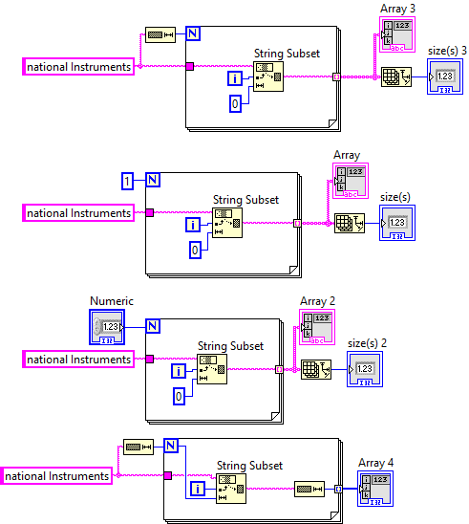
Level one
Solve and give the answer of all Problem
Note:-

Slide 18
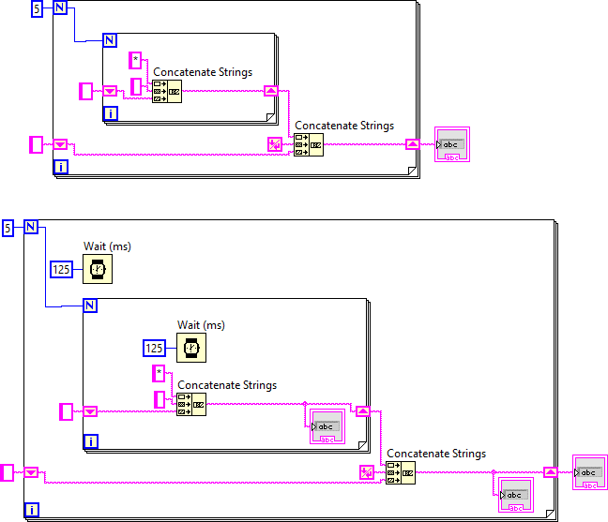
Level one
Solve and give the answer of all Problem
Note:-

Slide 19
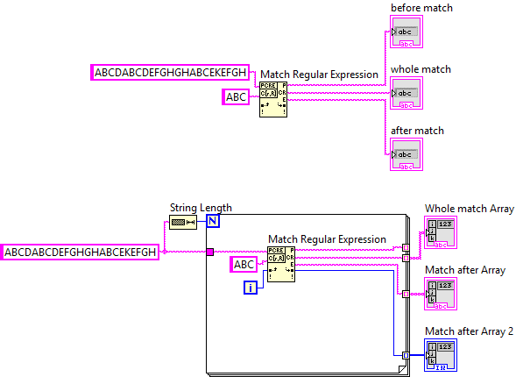
Level one
Solve and give the answer of all Problem
Note:-

Slide 20
Please Share with new LabVIEW users
Thank you

